Slide 1
R Workshop – Day 3
Randi L. Garcia
Smith College
July 17th, 19th, and 21st

Slide 2
Day 3
Multilevel Modeling
Growth Curve Modeling
Dyadic Data Analysis

Slide 3
Multilevel Modeling

Slide 4
Multilevel Modeling AKA…
Hierarchical Linear Model (HLM)
Because of the popular program crated by Raudenbush, Bryk et al.
Random coefficient models
Mixed-effects models
Mixed linear models
This is what it’s called in statistics
Multilevel regression models

Slide 5
Nested Data
Whenever you have nested data you (probably) need MLM
Students in classrooms
Therapists’ ratings of their classrooms
People in romantic couples (dyads)
Participants within a cluster are more similar to each other than two participants in different clusters
Statistical techniques you have learned so far require independent observations
Observations are not independent when we have nested data
If we know something about Jim’s wife’s satisfaction, then we already know little something about Jim’s satisfaction

Slide 6




Consequences of Ignoring Nested Data
When each participant does not give independent pieces of info, the effective sample size is reduced
If sample size is bigger than it should be, standard errors are too small, so t-statistics too big, and finally, p-values are too small!
SE’s and p-values are biased, test are too liberal
Coefficients are unchanged
$$SE=\left(\frac{s}{\sqrt{N}}\right)$$
$$t= \frac{b}{SE}$$
$$N$$
$$p value$$

Slide 7
Fixed vs. Random Effects
MLM includes specifying fixed and random effects in one linear model (hence: “mixed”)
The levels of a fixed factor are assumed to be a complete picture of that variable
If we are interested in gender and we have men and women in our sample—there is no other level of gender we could have included
The levels of a random factor are a random sample of possible levels
If we have different dosages—there are other possible dosages we could have selected

Slide 8
Fixed vs. Random Effects
For fixed effects, we look for mean differences between the conditions or levels
For random effects, we estimate the variance in means across all conditions because the actual mean difference from one condition to another isn’t really important
In ANOVA, testing these two effects is mathematically similar, the interpretation changes

Slide 9
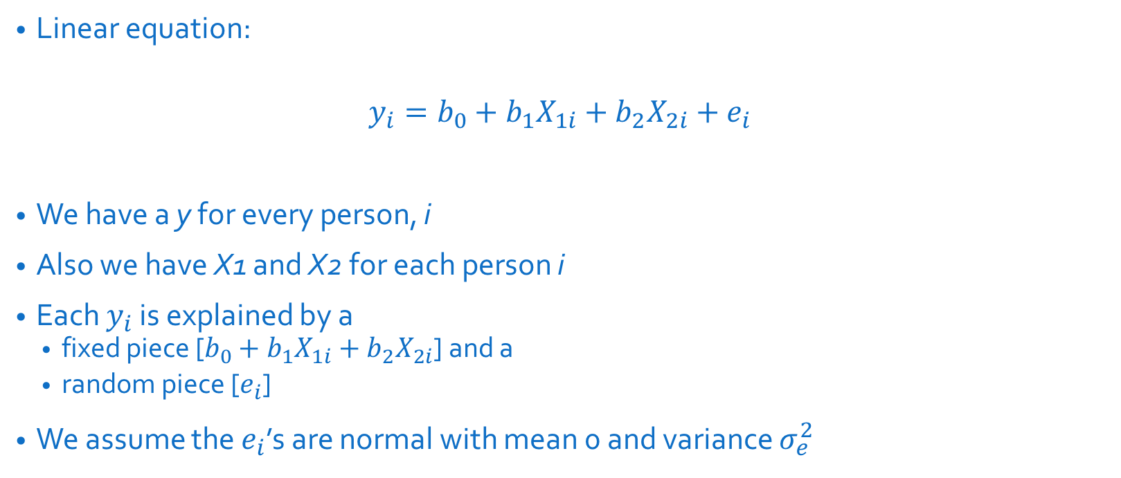
Multiple Regression Rewind
Linear equation:
$$y_{i}=b_{0}+b_{1}X_{1i}+b_{2}X_{2i}+e_{i}$$
We have a y for every person, i
Also we have X1 and X2 for each person i
Each $y_{i}$ is explained by a
fixed piece [$b_{0}+b_{1}X_{1i}+b_{2}X_{2i}$] and a
random piece [$e_{i}$]
We assume the $e_{i}$’s are normal with mean 0 and variance $σ_{e}^{2}$

Slide 10
What are two-level equations?
In multilevel modeling we want to predict the outcome variable at the micro level, but also group differences in that outcome variable at the macro level.
We need linear equations at both levels to capture these effects.
Two-level versus combined equation for MLM
We can present our linear equations at both levels in a set of separate equations, OR
We can combine the set of equations into one simplified combined equation.

Slide 11
The Most Basic MLM
Example: our outcome (y) is popularity of children in classes
First, no predictors of y
Question: Do some classrooms have pupils that are more popular than other classrooms?
y

Slide 12
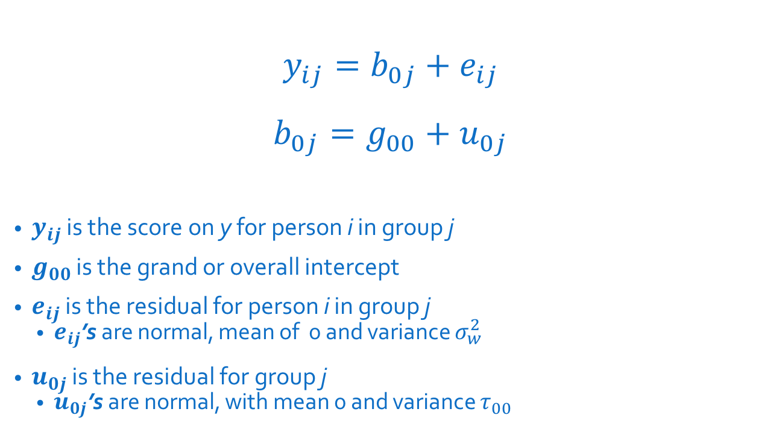
The Most Basic MLM
$$y_{ij}=b_{0j}+e_{ij}$$
$$b_{0j}=g_{00}+u_{0j}$$
$y_{ij}$ is the score on y for person i in group j
$g_{00}$ is the grand or overall intercept
$e_{ij}$ is the residual for person i in group j
$e_{ij}$’s are normal, mean of 0 and variance $σ_{w}^{2}$
$u_{0j}$ is the residual for group j
$u_{0j}$’s are normal, with mean 0 and variance $τ_{00}$
Micro level
Macro level

Slide 13
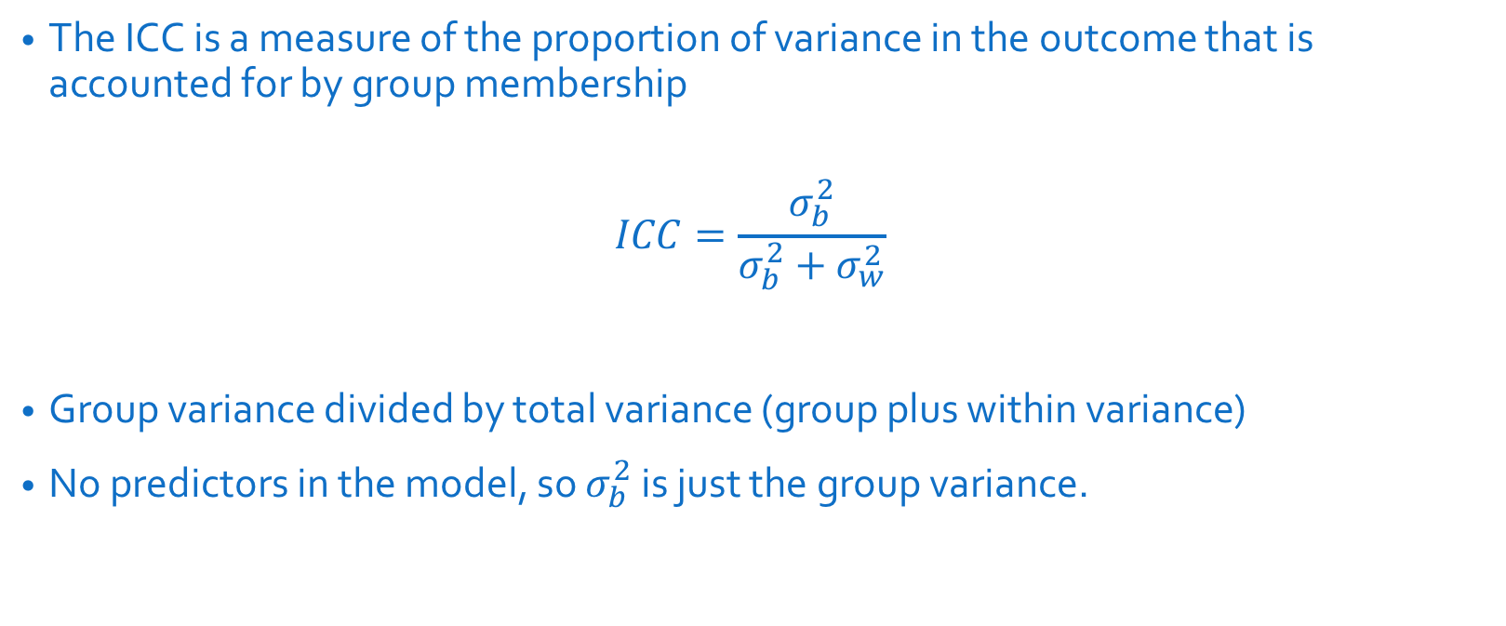
Intraclass Correlation (ICC)
The ICC is a measure of the proportion of variance in the outcome that is accounted for by group membership
$$ICC=\frac{σ_{b}^{2}}{σ_{b}^{2}+σ_{w}^{2}}$$
Group variance divided by total variance (group plus within variance)
No predictors in the model, so $σ_{b}^{2}$ is just the group variance.

Slide 14
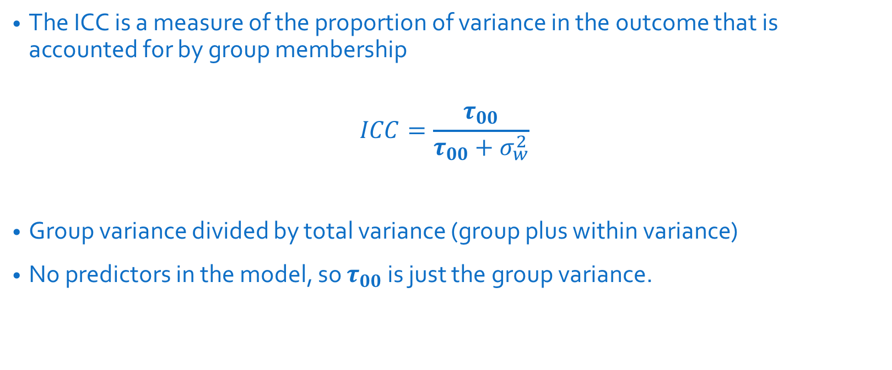
Intraclass Correlation (ICC)
The ICC is a measure of the proportion of variance in the outcome that is accounted for by group membership
$$ICC=\frac{τ_{00}}{τ_{00}+σ_{w}^{2}}$$
Group variance divided by total variance (group plus within variance)
No predictors in the model, so $τ_{00}$ is just the group variance.

Slide 15
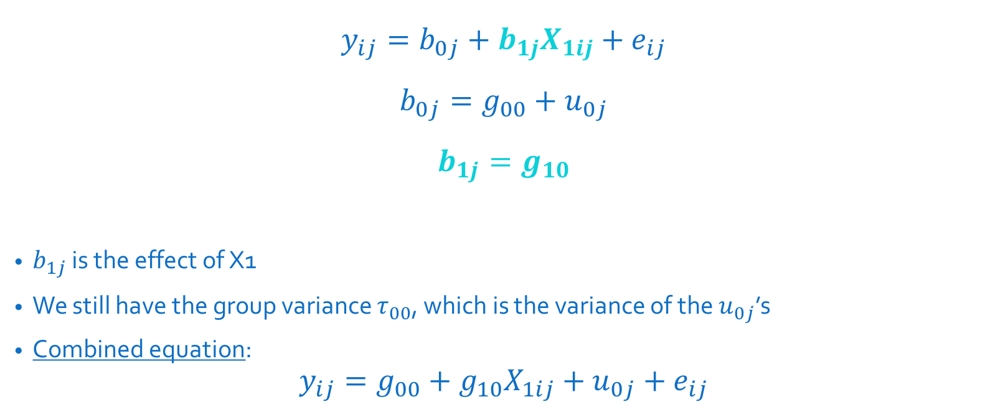
Adding a Level 1 Predictor Fixed
$$y_{ij}=b_{0j}+b_{1j}X_{1ij}+e_{ij}$$
$$b_{0j}=g_{00}+u_{0j}$$
$$b_{1j}=g_{10}$$
$b_{1j}$ is the effect of X1
We still have the group variance $τ_{00}$, which is the variance of the $u_{0j}$’s
Combined equation:
$$y_{ij}=g_{00}+g_{10}X_{1ij}+u_{0j}+e_{ij}$$
Micro level
Macro level

Slide 16
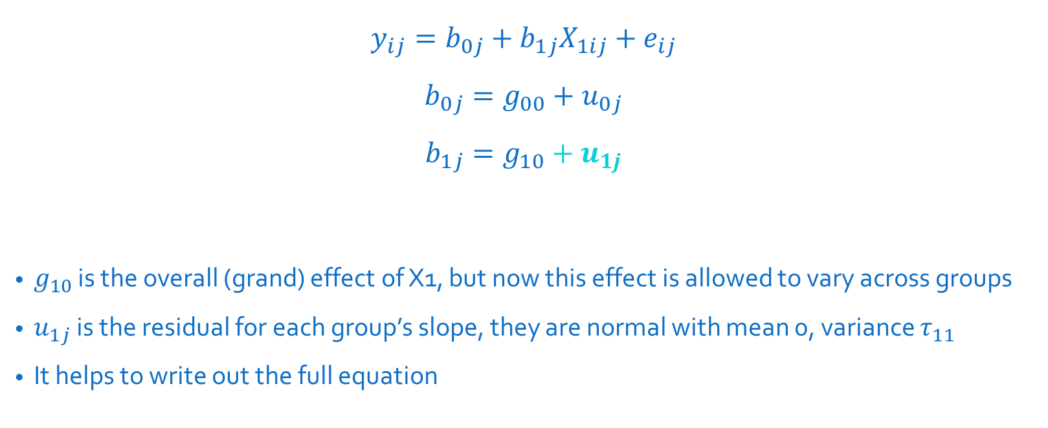
Adding a Level 1 Predictor w/ Random Component
$$y_{ij}=b_{0j}+b_{1j}X_{1ij}+e_{ij}$$
$$b_{0j}=g_{00}+u_{0j}$$
$$b_{1j}=g_{10}+u_{1j}$$
$g_{10}$ is the overall (grand) effect of X1, but now this effect is allowed to vary across groups
$u_{1j}$ is the residual for each group’s slope, they are normal with mean 0, variance $τ_{11}$
It helps to write out the full equation
Micro level
Macro level

Slide 17

Adding a Level 1 Predictor w/ Random Component
$$y_{ij}=b_{0j}+b_{1j}X_{1ij}+e_{ij}$$
$$b_{0j}=g_{00}+u_{0j}$$
$$b_{1j}=g_{10}+u_{1j}$$
Combined equation:
$$y_{ij}=g_{00}+g_{10}X_{1ij}+u_{1j}X_{1ij}+u_{0j}+e_{ij}$$

Slide 18
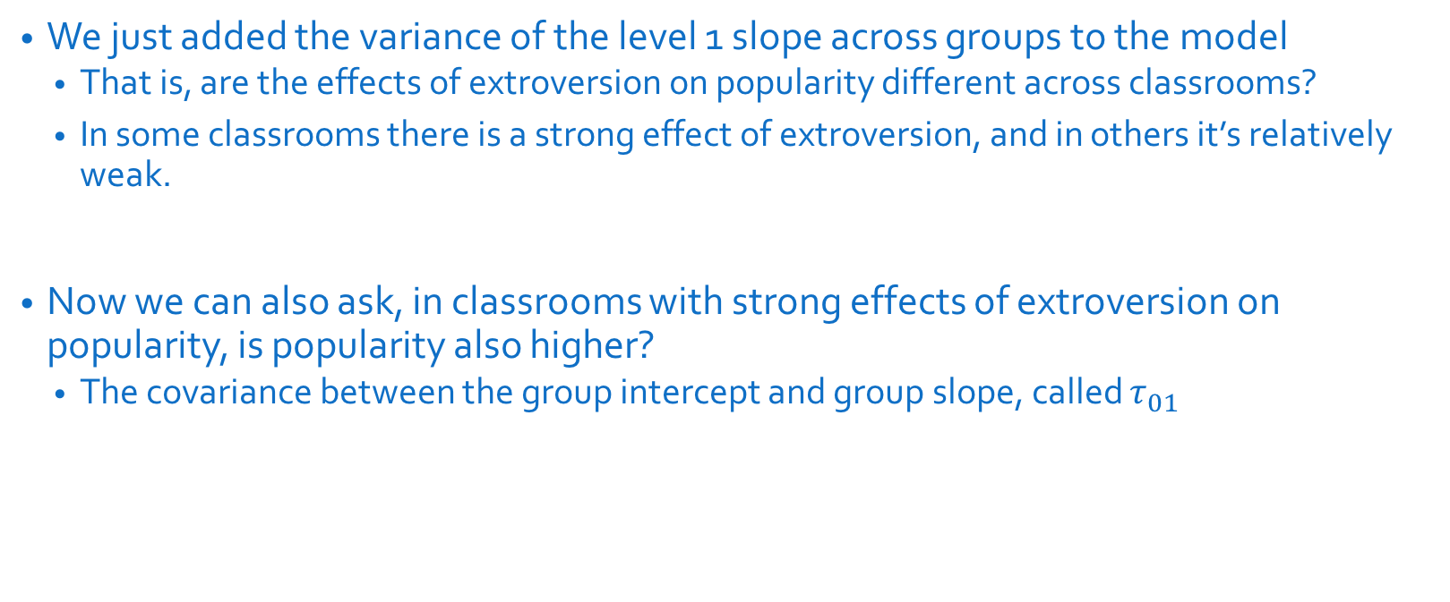
Covariance Matrix of Random Effects
We just added the variance of the level 1 slope across groups to the model
That is, are the effects of extroversion on popularity different across classrooms?
In some classrooms there is a strong effect of extroversion, and in others it’s relatively weak.
Now we can also ask, in classrooms with strong effects of extroversion on popularity, is popularity also higher?
The covariance between the group intercept and group slope, called $τ_{01}$

Slide 19
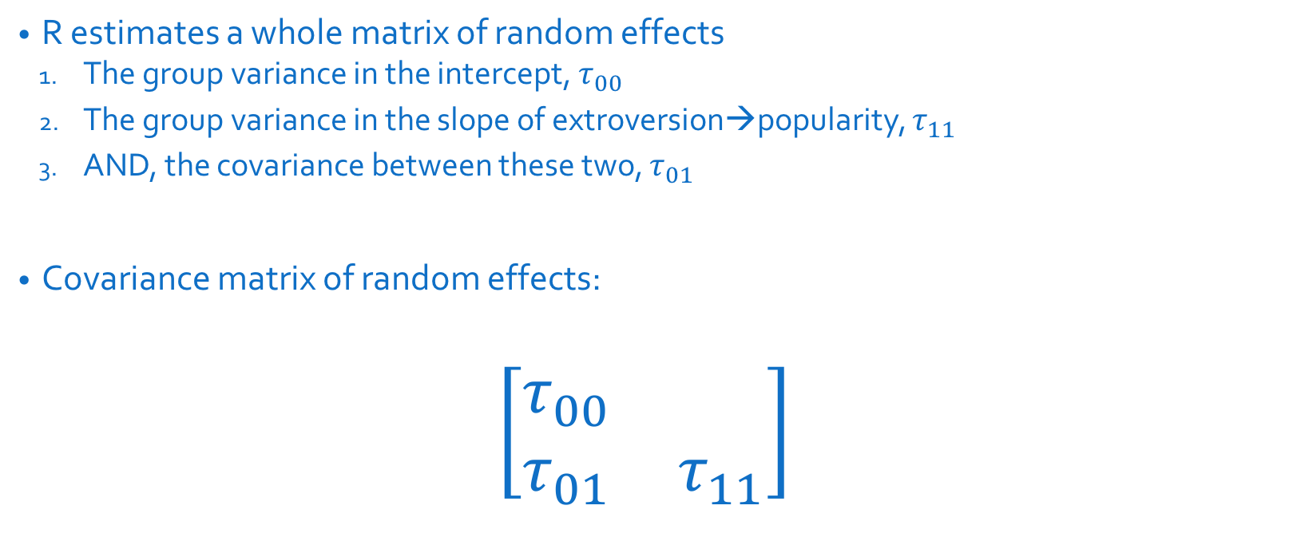
Covariance Matrix of Random Effects
R estimates a whole matrix of random effects
The group variance in the intercept, $τ_{00}$
The group variance in the slope of extroversion→popularity, $τ_{11}$
AND, the covariance between these two, $τ_{01}$
Covariance matrix of random effects:
$$\left[\begin{matrix}τ_{00} & \\ τ_{01} & τ_{11}\end{matrix}\right]$$

Slide 20
R Markdown file

Slide 21
Generalized Linear Mixed Models

Slide 22
Generalized Linear Models
In general we wrap the response variables in a link function (log, logit, probit, identity, etc.).
For example
A logistic regression is a generalized linear model making use of a logit link function.
A log-linear of Poisson regression is a generalized linear model making use of a log link function.
A regression model is a generalized linear model making use of an “identity” link function—the response is multiplied by 1.

Slide 23

Logistic Regression Review
DV is dichotomous
probability of belonging to group 1:$P_{1}$
probability of belonging to group 0: $P_{0}$ = $1−P_{1}$.
There are only two choices!

Slide 24
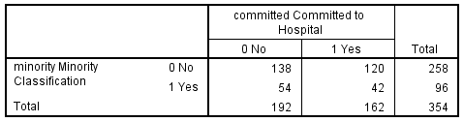
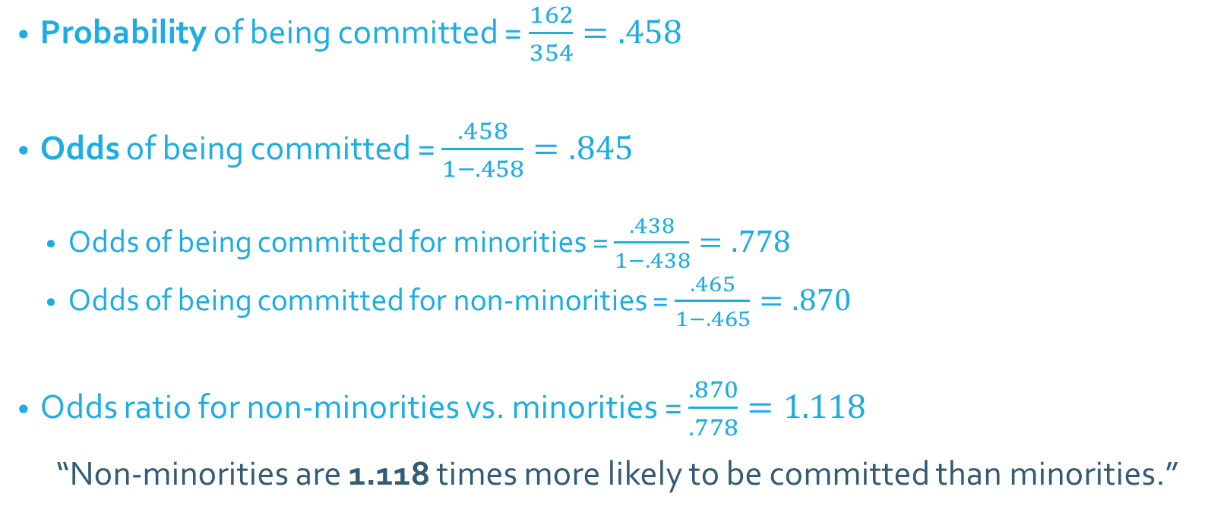
Odds and Odds Ratios
Probability of being committed = $\frac{162}{354}=.458$
Odds of being committed = $\frac{.458}{1−.458}=.845$
Odds of being committed for minorities = $\frac{.438}{1−.438}=.778$
Odds of being committed for non-minorities = $\frac{.465}{1−.465}=.870$
Odds ratio for non-minorities vs. minorities = $\frac{.870}{.778}=1.118$
“Non-minorities are 1.118 times more likely to be committed than minorities.”

Slide 25

Logistic Regression Equation
$$\ln\left(\frac{\hat{P_{1}}}{1−\hat{P_{1}}}\right)=b_{0}+b_{1}X_{1}+b_{2}X_{2}+…+b_{n}X_{n}$$
Where $\hat{P_{1}}$ is the predicted probability of being in group coded as 1
$\frac{\hat{P_{1}}}{1−\hat{P_{1}}}$ is the odds of being in group 1
$\ln\left(\frac{\hat{P_{1}}}{1−\hat{P_{1}}}\right)$ is the “logit” function

Slide 26
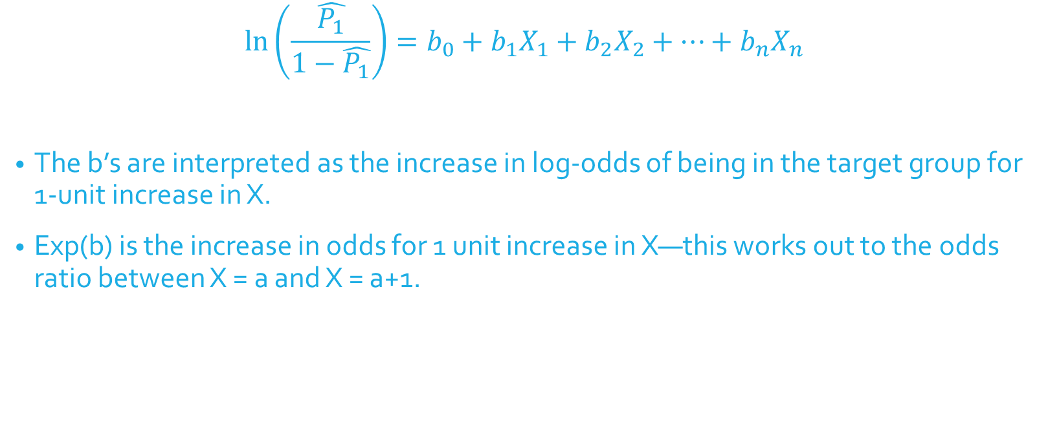
Logistic Regression Equation
$$\ln\left(\frac{\hat{P_{1}}}{1−\hat{P_{1}}}\right)=b_{0}+b_{1}X_{1}+b_{2}X_{2}+…+b_{n}X_{n}$$
The b’s are interpreted as the increase in log-odds of being in the target group for 1-unit increase in X.
Exp(b) is the increase in odds for 1 unit increase in X—this works out to the odds ratio between X = a and X = a+1.

Slide 27
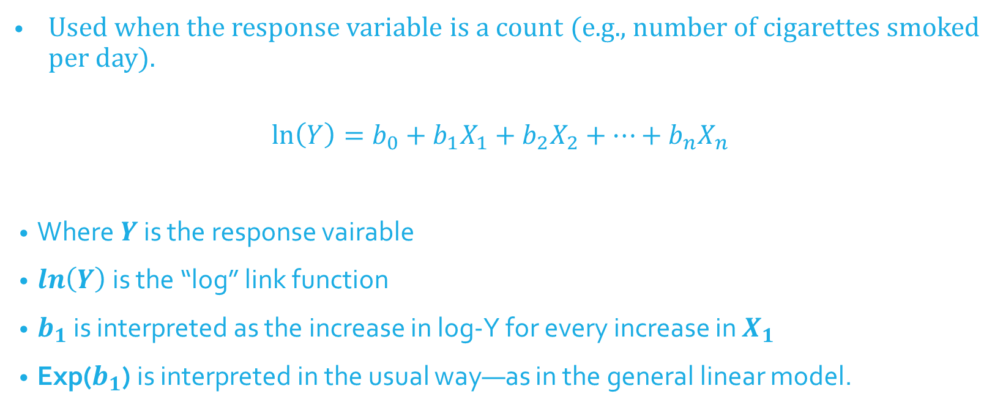
Log-Linear (Poisson) Regression Equation
Used when the response variable is a count (e.g., number of cigarettes smoked per day).
$$\ln\left(Y\right)=b_{0}+b_{1}X_{1}+b_{2}X_{2}+…+b_{n}X_{n}$$
Where$Y$ is the response vairable
$\ln\left(Y\right)$ is the “log” link function
$b_{1}$ is interpreted as the increase in log-Y for every increase in $X_{1}$
Exp($b_{1}$) is interpreted in the usual way—as in the general linear model.

Slide 28
Generalized Mixed Linear Models
Generalized linear models
In general we wrap the response in a link function (log, logit, probit, identity, etc.).
Generalized Mixed Linear Models
Do the same, include a link function that is appropriate for your response, but then include random effects in the model.
“Mixed” refers to the mixture of fixed and random effects in the model.
We’ll fit these models with the lme4 package in R, specifically, the glmer() function.

Slide 29
Generalized Estimating Equations (GEE)
Nonindependence treated as a “nuisance” to be removed; no statistical tests of nonindependence
Can be extended to:
Binomial outcome
Multinomial outcome (Categories: home/work/leisure)
Count data (Poisson, negative binomial)
Can also be used for continuous outcomes (normal distribution)
Fit these models with the gee package in R, specifically, the gee() function.

Slide 30
R Markdown file

Slide 31
Dyadic Data Analysis

Slide 32
Definitions: Distinguishability
Can all dyad members be distinguished from one another based on a meaningful factor?
Distinguishable dyads
Gender in heterosexual couples
Patient and caregiver
Race in mixed race dyads

Slide 33
All or Nothing
If most dyad members can be distinguished by a variable (e.g., gender), but a few cannot, then can we say that the dyad members are distinguishable?
No, we cannot!
33

Slide 34
Indistinguishability
There is no systematic or meaningful way to order the two scores
Examples of indistinguishable dyads
Same-sex couples
Twins
Same-gender friends
Mix of same-sex and heterosexual couples
When all dyads are hetero except for even one couple!

Slide 35
It can be complicated…
Distinguishability is a mix of theoretical and empirical considerations.
For dyads to be considered distinguishable:
It should be theoretically important to make such a distinction between members.
Also it should be shown that empirically there are differences.
Sometimes there can be two variables that can be used to distinguish dyad members: Spouse vs. patient; husband vs. wife.
35

Slide 36
Types of Variables
Between Dyads
Variable varies from dyad to dyad, BUT within each dyad all individuals have the same score
Example: Length of relationship
Called a level 2, or macro variable in multilevel modeling

Slide 37
A
A
A
B
A
B
B
A
A
B
Between

Slide 38
Within Dyads
Variable varies from person to person within a dyad, BUT there is no variation on the dyad average from dyad to dyad.
Percent time talking in a dyad
Reward allocation if each dyad is assigned the same total amount
X1 + X2 equals the same value for each dyad
Note: If in the data, there is a dichotomous within-dyads variable, then dyad members can be distinguished on that variable. But that doesn’t mean it would be theoretically meaningful to do so.

Slide 39
B
B
A
B
A
B
A
B
A
A
Within

Slide 40
Mixed Variable
Variable varies both between dyads and within dyads.
In a given dyad, the two members may differ in their scores, and there is variation across dyads in the average score.
Age in married couples
Lots-o personality variables
Most outcome variables are mixed variables.

Slide 41
It can be complicated…
Can you think of a variable that can be between-dyads, within-dyads, or mixed across different samples?
41

Slide 42
Data Structures

Slide 43
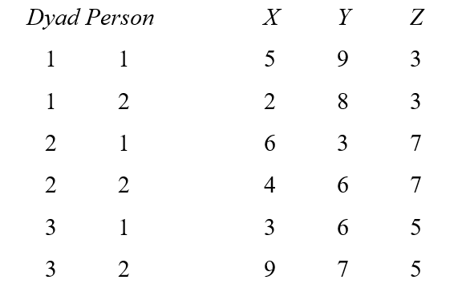
Illustration of Data Structures: Individual

Slide 44
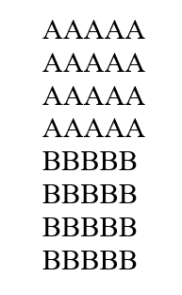
Illustration of Data Structures: Individual

Slide 45
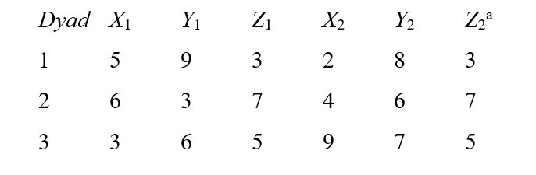
Illustration of Data Structures: Dyad

Slide 46
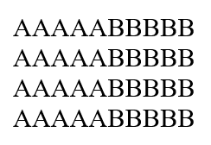
Illustration of Data Structures: Dyad

Slide 47
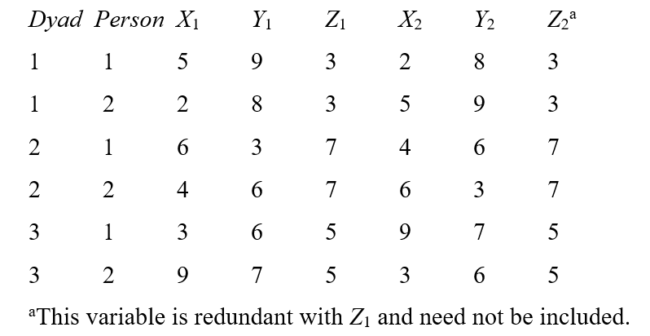
Illustration of Data Structures: Pairwise

Slide 48
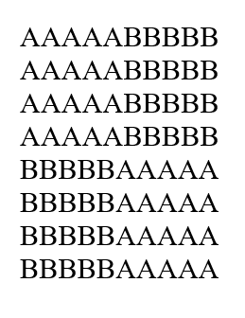
Illustration of Data Structures: Pairwise

Slide 49
R Markdown file

Slide 50
Nonindependence in DYads

Slide 51
Negative Nonindependence
Nonindependence is often defined as the proportion of variance explained by the dyad (or group).
BUT, nonindependence can be negative…variance cannot!
This is super important
THE MOST IMPORTANT THING ABOUT DYADS!

Slide 52
How Might Negative Correlations Arise?
Examples
Division of labor: Dyad members assign one member to do one task and the other member to do another. For instance, the amount of housework done in the household may be negatively correlated.
Power: If one member is dominant, the other member is submissive. For example, self-objectification is negatively correlated in dyadic interactions.

Slide 53
Effect of Nonindependence
Consequences of ignoring clustering classic MLM
Effect Estimates Unbiased
For dyads especially
Standard Errors Biased
Sometimes too large
Sometimes too small
Sometimes hardly biased

Slide 54
Direction of Bias Depends on
Direction of Nonindependence
Positive
Negative
Is the predictor a between or within dyads variable? (or somewhere in between: mixed)

Slide 55
Effect of Ignoring Nonindependence on Significance Tests

Slide 56
What Not To Do!
Ignore it and treat individual as unit
Discard the data from one dyad member and analyze only one members’ data
Collect data from only one dyad member to avoid the problem
Treat the data as if they were from two samples (e.g., doing an analysis for husbands and a separate one for wives)
Presumes differences between genders (or whatever the distinguishing variable is)
Loss of power

Slide 57
What To Do
Consider both individual and dyad in one analysis!
Multilevel Modeling
Structural Equation Modeling

Slide 58
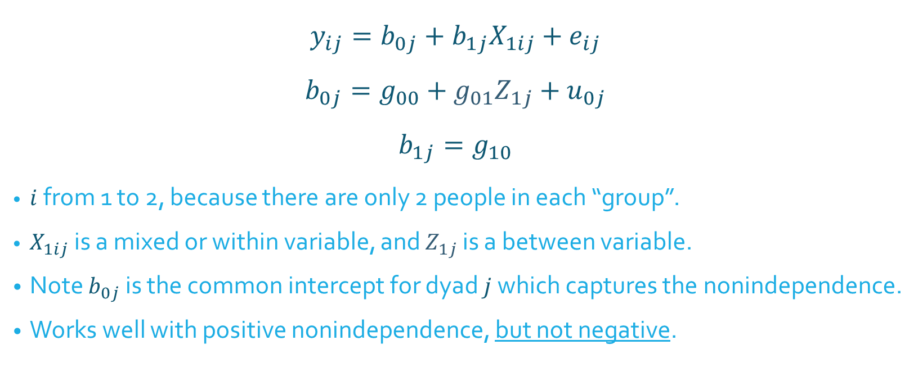
Traditional Model: Random Intercepts
$$y_{ij}=b_{0j}+b_{1j}X_{1ij}+e_{ij}$$
$$b_{0j}=g_{00}+g_{01}Z_{1j}+u_{0j}$$
$$b_{1j}=g_{10}$$
$i$ from 1 to 2, because there are only 2 people in each “group”.
$X_{1ij}$ is a mixed or within variable, and $Z_{1j}$ is a between variable.
Note $b_{0j}$ is the common intercept for dyad $j$ which captures the nonindependence.
Works well with positive nonindependence, but not negative.
Micro level
Macro level

Slide 59
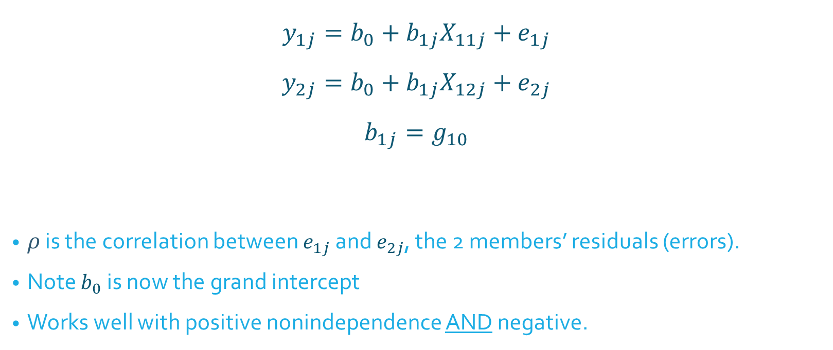

Alternative Model: Correlated Errors
$$y_{1j}=b_{0}+b_{1j}X_{11j}+e_{1j}$$
$$y_{2j}=b_{0}+b_{1j}X_{12j}+e_{2j}$$
$$b_{1j}=g_{10}$$
$ρ$ is the correlation between $e_{1j}$ and $e_{2j}$, the 2 members’ residuals (errors).
Note $b_{0}$ is now the grand intercept
Works well with positive nonindependence AND negative.
$ρ$ called “rho”
Micro level
Macro level

Slide 60
Actor-Partner Interdependence Model (APIM)

Slide 61
Actor-Partner Interdependence Model (APIM)
A model that simultaneously estimates the effect of a person’s own variable (actor effect) and the effect of same variable but from the partner (partner effect) on an outcome variable
The actor and partner variables are the same variable from different persons.
All individuals are treated as actors and partners.

Slide 62
Data Requirements
Two variables, X and Y, and X causes or predicts Y
Both X and Y are mixed variables—both members of the dyad have scores on X and Y.
Example
Dyads, one a patient with a serious disease and other being the patient’s spouse. We are interested in the effects of depression on relationship quality

Slide 63
Actor Effect
Definition: The effect of a person’s X variable on that person’s Y variable
the effect of patients’ depression on patients’ quality of life
the effect of spouses’ depression on spouses’ quality of life
Both members of the dyad have an actor effect.

Slide 64
Partner Effect
Definition: The effect of a person’s partner’s X variable on the person’s Y variable
the effect of patients’ depression on spouses’ quality of life
the effect of spouses’ depression on patients’ quality of life
Both members of the dyad have a partner effect.

Slide 65
Distinguishability and the APIM
Distinguishable dyads
Two actor effects
An actor effect for patients and an actor effect for spouses
Two partner effects
A partner effect from spouses to patients and a partner effect from patients to spouses

Slide 66
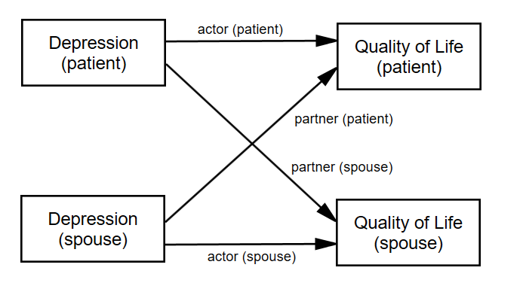
Distinguishable Dyads
Errors not pictured (but important)
The partner effect is fundamentally dyadic. A common convention is to refer to it by the outcome variable. Researcher should be clear!

Slide 67
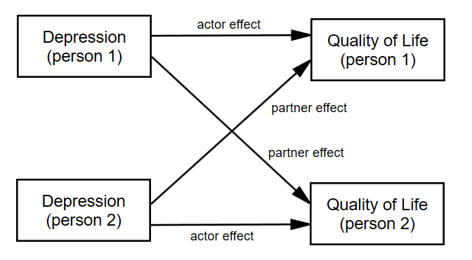
Indistinguishable Dyads
The two actor effects are set to be equal and the two partner effects are set to be equal.

Slide 68
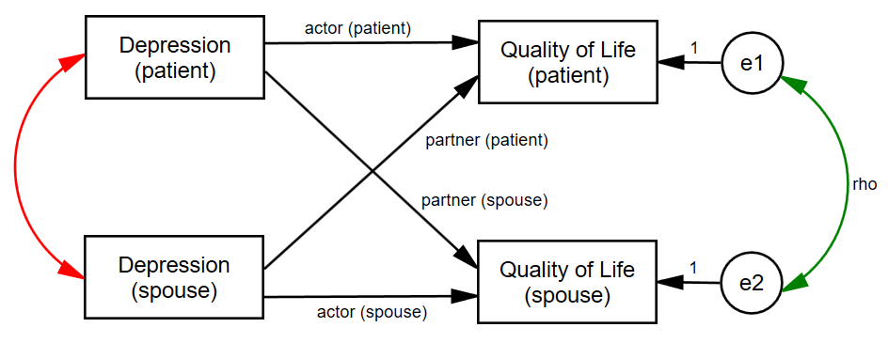
Nonindependence in the APIM
Green curved line: Nonindependence in Y
Red curved line: X as a mixed variable (r cannot be 1 or -1)
Note that the combination of actor and partner effects explain some of the nonindependence in the dyad.

Slide 69
R Markdown file

Slide 70
Growth Curve Modeling

Slide 71
Examples of Over-Time Dyadic Data
Daily diary reports of relationship experiences from both members of heterosexual dating partners over 14 days
Repeated measures experiment where dyads interact with each other multiple times and make ratings after each interaction
Daily reports of closeness from both members of college roommate dyads

Slide 72
Basic Data Structure
The three-level nested myth: Time is nested within person and person is nested within dyad
Three-level nested only if the four time points differ such that T1a ≠ T1b, T2a ≠ T2b, etc.

Slide 73
Basic Data Structure
Dyad 1
In most cases the two dyad members are measured at the same time points, so Time is crossed with person.
Husband
Wife
T1
H_T1
W_T1
T2
H_T2
W_T2
T3
H_T3
W_T3
T4
H_T4
W_T4

Slide 74
Basic Data Structure
This two-level crossed structure results in an error structure in which the residuals may be correlated both
across dyad members
across time
H - Time 1
H - Time 2
H - Time 3
H - Time 4
Satisfaction
Satisfaction
Satisfaction
Satisfaction
eM1
eM2
eM3
em4
eF1
eF2
eF3
eF4
W - Time 1
W - Time 2
W - Time 3
W - Time 4
Satisfaction
Satisfaction
Satisfaction
Satisfaction

Slide 75
Types of Over-Time Models
Repeated Measures Model
Interest only in the effects of “time” across persons and dyads.
Growth Curve Model
Are there linear changes over time in the outcome variable?
Stability and Influence Model
Stability: Does Person A’s score at time 1 predict Person A’s score at time 2?
Influence: Does Person A’s score at time 1 predict Person B’s score at time 2?
Standard APIM
Different variables as the predictors and at the outcome
Does Variable 1 predict Variable 2?

Slide 76
Types of Variables
Time Invariant
Do not change over time
Measured at one time point only (typically the beginning of the study)
E.g., gender, attachment style, race
Time Varying
Measured at each time
E.g., daily mood, twice-weekly reports of friendship
Outcome variable must be time varying

Slide 77
How Many Time Points?
Depends on type of analysis
The more complicated the model, the more time points needed
Minimum
Repeated measures: Two
Other models: Three
More is better.
Ultimately depends on the model, the research setting, and research questions.

Slide 78
Example: Daily reports of conflict, support, and relationship satisfaction
Kashy data set
103 heterosexual dating couples
Assessed once daily for 14 days
Completed daily reports of relationship satisfaction and amount of conflict that day
Satisfaction and Conflict are time-varying
Pretest data for attachment avoidance
Measured for both people
Time invariant
Notes:
Only going to talk about satisfaction and attachment avoidance data
-back to kashy data

Slide 79
Person Period Pairwise Dataset
Each Person by Time combination has its own record
Person has its own variable (e.g., Person = 1, 2)
Occasion has its own variable (e.g., Day = 1 to 14)
Required for Multilevel Modeling
We’ll look at it when we get to R

Slide 80
Modeling Two Growth Curves
Y_{Wti} = c_{Wi} + b_{Wi}T_{ti} + e_{Wti}
Y_{Mti} = c_{Mi} + b_{Mi}T_{ti} + e_{Mti}
Intercepts
c_{Wi} = Predicted value of women’s satisfaction at study midpoint for dyad i
c_{Mi} = Predicted value of men’s satisfaction at study midpoint for dyad i
Slopes
b_{Wi} = Average change in women’s satisfaction over time for dyad i
b_{Mi} = Average change in men’s satisfaction over time for dyad I
Errors at each time point
Women = e_{Wti}
Men = e_{Mti}

Slide 81
Correlation of the Residuals
If the man reports more satisfaction for a particular day than would be expected given the overall effect of time, does the woman also report more satisfaction for that day?

Slide 82
Random Effects: Variances
There are six variances
two intercepts
Do men (and women) differ from each other in their “time zero” predicted score?
two slopes for time
Do the slopes for men (and women) differ?
two error (distance from the line) variances
Error variances (deviations from the slope) for men and women

Slide 83
Random Effects: Within Person Correlations
Man intercept-slope correlation
If a man is highly satisfied at the study midpoint, is his change in satisfaction steeper?
Woman intercept-slope correlation
If a woman is highly satisfied at the study midpoint, is her change in satisfaction steeper?
83
Notes:
83
Make these faint (they need to be in here but we aren’t going to talk about them)

Slide 84
Four Between-Person Correlations
Correlation of the intercepts between partners
Overall, do women who have higher levels of satisfaction at the study midpoint tend to have male partners who are also higher in satisfaction at the study midpoint?
That is: Is there a correspondence between level of satisfaction?
Correlation of the slopes
Do women whose satisfaction changes over time tend to have male partners whose satisfaction also changes over time?
That is: Is there a correspondence between linear change in satisfaction?
Two slope-intercept correlations
Do women with higher levels of satisfaction have male partners who increase or decrease?
Do men with higher levels of satisfaction have female partners who increase or decrease
Notes:
Do we want to keep all of this?
-lighten these up. Emphasize the first two (less the third)

Slide 85
Estimates of Random Effects
 |  | Man Intercept | Woman Intercept | Man Time Slope | Woman Time Slope
Man Intercept | sd
Woman Intercept | sd | r
Man Slope | sd | r | r
Woman Slope | sd | r | r | r
Residual | sd
Rho
The random option specifies the variances (given as standard deviations) and covariances (given as correlations) between the intercepts and slopes

Slide 86
R Markdown file

